Slide 1
Employee Data Analysis using Excel
STUDENT NAME:Vinoth.P
REGISTER NO: 312220315
DEPARTMENT: III – B.Com Computer Application (Commerce)
COLLEGE: Jeppiaar College of Arts and Science

Slide 2
PROJECT TITLE
Employee Salary Analysis using Excel

Slide 3


AGENDA
Problem Statement
Project Overview
End Users
Our Solution and Proposition
Dataset Description
Modelling Approach
Results and Discussion
Conclusion
3/21/2024 Annual Review

Slide 4

PROBLEM STATEMENT
Here's a concise problem statement for an employee salary analysis:
Problem Statement:_"Unclear and inconsistent salary structure leads to inequitable pay, talent attraction and retention challenges, and low employee satisfaction. We need a comprehensive salary analysis to ensure fair, competitive, and transparent compensation practices."This brief problem statement highlights the main issue and the need for a salary analysis to address it.

Slide 5
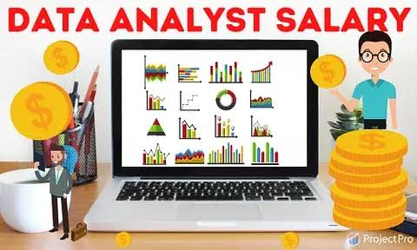
PROJECT OVERVIEW
Using excel, I aim to calculate summary statistics for salaries by department, job title, and gender. Visualize findings using charts and graphs. Inform salary increase decisions and budget allocations. Develop recommendations for salary adjustments and policy changes.

Slide 6



WHO ARE THE END USERS?
HR Department
Management
Employees
Recruitment Team
Line manager
Compensation and benefits team

Slide 7

OUR SOLUTION AND ITS VALUE PROPOSITION
Enhanced Employee Satisfaction - Transparent and fair salary practices.
Sort & Filter - Remove the Blank Missing Values.
Conditional Formatting - To Highlight the Blanks cells and change the colour of the cell.
Pivot Tables - Summary of Employee Turnover from the Company through job satisfaction.
Formulas
Graphs - (Bar Chart & Pie Chart) – FINAL REPORT on Employee Salary Analysis

Slide 8
Dataset Description
Employee salary dataset – Kaggle.com
Variables :
Employee Id = <int>Numerical Values
Name = <int>Text Values
Salary = <int>Numerical Values
Job Title = <int>Text Values
Department = <int>Text Values
Gender = <fct> Text Values(Female or Male)
Experience = <int>Numerical Values
Location = <int>Text Values

Slide 9

THE "WOW" IN OUR SOLUTION
W_ (Winners):- Fair salaries- Transparent pay structure- Performance-based raises
O_ (Opportunities):- Improved retention- Increased productivity- Better talent attraction
W_ (Woes):- Potential increased costs- Implementation challenges- Employee resistance
3/21/2024 Annual Review
9

Slide 10
MODELLING
Dataset collection - Employee Salary Dataset
Dataset Preparation - Clearing Blanks, Filtering and removing Blank data in the database.
Using VLOOKUP formula to find an Employees salary.
Insert Pivot Table to summarize the dataset on employee salary based on gender, trends and jab title.
Data visualization using Bar Chart and Pie chart to represent the turnover by gender.
Final Report
10

Slide 11
RESULTS
BAR CHART VISUALISATION
11

Slide 12
RESULTS
PIE CHART VISUALISATION

Slide 13
conclusion
Our salary analysis reveals opportunities to improve internal equity and competitiveness. We recommend regular salary reviews, a clear compensation philosophy, and benefits package enhancements to create a fairer and more competitive structure. By addressing these areas, we can better attract, retain, and reward top talent.

